Slide 1
EVIL AND OMNIPOTENCE
J. L. MACKIE

Slide 2
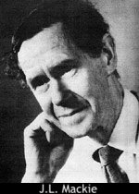
JOHN LESLIE MACKIE
(1917-1981)

Slide 3
MACKIE’S PROJECT
To show that
“…several parts of the essential theological doctrine are inconsistent with one another” (p. 83, my emphasis).

Slide 4
THE PROBLEM (OF EVIL)
“God is ominipotent; God is wholly good; and yet evil exists. There seems to be some contradiction between these three propositions.” (p. 83)

Slide 5
MACKIE’S PROJECT (CONT’)
“ He [the theist] must now be prepared to believe…what can be disproved from his other beliefs….” (Ibid.)

Slide 6
VERY BOLD PROJECT!
If Mackie is correct, then theism (as we have been construing it) is doomed. Although a few philosophers, and non-philosophers, have been willing to maintain a belief in the face of a contradiction, for us (or me, anyway), this is the bottom line. Contradictory beliefs cannot all be true.

Slide 7
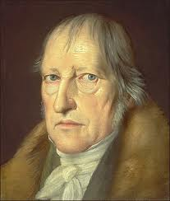

DIGRESSION: SOME PHILOSOPHERS WHO HAVE ACCEPTED CONTRADICTIONS
Georg Wilhelm Friedrich Hegel
(1770-1831)

Slide 8
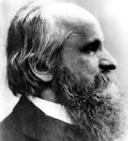

ALEXIUS VON MEINONG
(1853-1920)

Slide 9
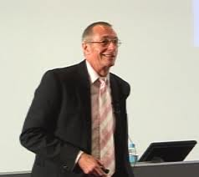

GRAHAM PRIEST
(1948 - )

Slide 10
THE DEDUCTIVE VERSION OF THE ARGUMENT FROM EVIL
RECONSTRUCTION OF J. L. MACKIE’S ATTEMPT TO PROVE THAT EVIL IS INCOMPATIBLE WITH THE EXISTENCE OF GOD

Slide 11
P1. IF GOD EXISTS, THEN HE IS OMNIPOTENT, OMNISCIENT AND ALL GOOD.
P2. THERE HAVE EXISTED EVILS (WHICH IT WAS POSSIBLE TO PREVENT).
_________________
C. GOD DOES NOT EXIST.

Slide 12
MACKIE PROJECT
GOAL: TO SHOW THAT THIS ARGUMENT IS DEDUCTIVELY VALID.
PROCEDURE: TO ADD NECESSARILY TRUE AUXILIARY PREMISES (“QUASI-LOGICAL ‘RULES’”) AND TO DEDUCE THE CONCLUSION
C FROM P1 &P2 AND THESE.
JUSTIFICATION: IF A CORRECT LOGICAL PROOF FROM GIVEN PREMISES CAN BE CONSTRUCTED USING ONLY NECESSARY TRUTHS AS AUXILIARY PREMISES, THEN THE ORIGINAL ARGUMENT IS DEDUCTIVELY VALID.

Slide 13
SOME “QUASI-LOGICAL” PRINCIPLES
N1. IF GOD IS OMNIPOTENT, THEN HE CAN DO ANYTHING THAT IS LOGICALLY POSSIBLE.
N2. IF GOD IS OMNISCIENT, THEN HE KNOWS EVERYTHING THAT IS TRUE.
N3. IF GOD HAD PREVENTED SOMETHING, THEN IT WOULD NOT HAVE EXISTED.

Slide 14
N4. IF THERE HAVE BEEN EVILS WHICH COULD POSSIBLY HAVE BEEN PREVENTED, AND GOD KNEW ABOUT THEM , AND HE KNEW THAT HE COULD HAVE PREVENTED THEM, AND IS ALL GOOD, THEN HE WOULD HAVE PREVENTED THEM.

Slide 15
LOGICAL EXERCISE
SHOW THAT FROM P1 AND P2, USING N1-N4 AS AUXILIARY PREMISES, THE CONCLUSION C CAN BE DEDUCED.
Note: This deduction can be carried out using correct rules of logic

Slide 16
“NOW WE CAN CONCLUDE, FROM THE ASSUMPTION THAT GOD HAS THESE PROPERTIES --IF HE EXISTS -- THAT LOGICALLY PREVENTABLE EVILS DO NOT EXIST. BUT SUCH EVILS DO EXIST, SO …”

Slide 17
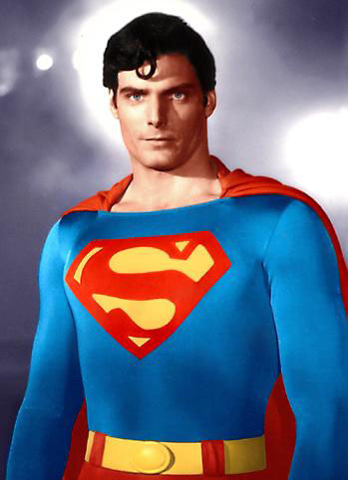
NOT SO FAST, FALLACY BREATH !!
LOGIC MAN

Slide 18
IF THE AUXILIARY PREMISES ARE NOT ALL NECESSARILY TRUE, THEN IT WILL NOT HAVE BEEN SHOWN THAT GOD’S PROPERTIES ARE THEMSELVES INCOMPATIBLE WITH THE SHEER EXISTENCE OF EVIL.
WE CONSIDER THEM ONE BY ONE.

Slide 19
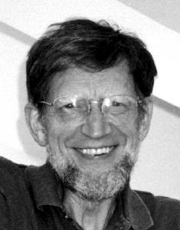
LOGIC MAN IN DISGUISE (AS MILD-MANNERED PHILSOPHER)
ALVIN PLANTINGA

Slide 20
N4. IF THERE HAVE BEEN EVILS WHICH COULD POSSIBLY HAVE BEEN PREVENTED, GOD KNEW ABOUT THEM , KNEW THAT HE COULD HAVE PREVENTED THEM, AND IS (AND WAS) ALL GOOD, THEN HE WOULD HAVE PREVENTED THEM.
IF THIS IS NOT A NECESSARY TRUTH, THEN THE MACKIE-PROJECT FAILS. WHY IS THIS? WHY ISN’T IT A NECESSARY TRUTH? DOESN’T THE EXISTENCE OF EVIL COUNT AGAINST THE EXISTENCE OF GOD? WHAT’S GOING ON? HOW IS THIS RELATED TO PLANTINGA’S PAPER?

Slide 21
SOME LOGICAL OBSERVATIONS
SUPPOSE , FOR SIMPLICITY, THAT WE HAVE AN ARGUMENT WITH JUST TWO PREMISES
  P
Q
______
 R
THE ARGUMENT IS DEDUCTIVELY VALID IF AND ONLY IF IT IS IMPOSSIBLE FOR THE PREMISES TO BE TRUE AND, AT THE SAME TIME, FOR THE CONCLUSION TO BE FALSE

Slide 22
CONSIDER THE FOLLOWING SET OF STATEMENTS:
{ P, Q, not-R},
WHERE ‘not-R’ IS THE NEGATION
OF ‘R’.
IF THE ORIGINALLY GIVEN ARGUMENT IS DEDUCTIVELY VALID, WHAT CAN WE SAY ABOUT THIS SET OF STATEMENTS?

Slide 23
ANOTHER IMPORTANT LOGICAL POINT
  SUPPOSE WE CONSIDER THE ARGUMENT WHICH RESULTS WHEN AN ADDITIONAL PREMISE S IS ADDED:
  P
Q
S
______
 R

Slide 24
SUPPOSE ALSO THE ADDITIONAL PREMISE IS NECESSARILY TRUE
WHAT IS THE RELATION BETWEEN THE VALIDITY OF THIS NEW ARGUMENT AND THE VALIDITY OF OUR ORIGINAL ARGUMENT?
SUPPOSE WE CAN SHOW THAT THE NEW ARGUMENT IS DEDUCTIVELY VALID BY CORRECTLY DEDUCING ITS CONCLUSION R FROM THE THREE PREMISES? THEN WHAT WOULD WE KNOW ABOUT THE ORIGINAL?

Slide 25
PLANTINGA CONSIDERS WHETHER A CONTRADICTION CAN BE FORMALLY DEDUCED FROM THE SET:
{GOD IS OMNIPOTENT, GOD IS OMNISCIENT, GOD IS ALL GOOD, (PREVENTABLE) EVIL EXISTS}
IT IS DIFFICULT TO SEE HOW, BUT SUPPOSE WE ADD AS AUXILIARY PREMISES CERTAIN NECESSARY TRUTHS AND THEN WE CAN DEDUCE A CONTRADICTION. THEN WHAT?

Slide 26
HERE IS THE PROPOSITION WHICH WE ARE CURRENTLY CONSIDERING:
N4. IF THERE HAVE BEEN EVILS WHICH COULD POSSIBLY HAVE BEEN PREVENTED, GOD KNEW ABOUT THEM , KNEW THAT HE COULD HAVE PREVENTED THEM, AND IS (AND WAS) ALL GOOD, THEN HE WOULD HAVE PREVENTED THEM.
IS THIS A NECESSARY TRUTH?

Slide 27
WE HELP MACKIE BY SUGGESTING A DIFFERENT PREMISE TO BE ADDED:
N4*. IF THERE HAVE BEEN EVILS WHICH COULD HAVE BEEN PROPERLY PREVENTED, GOD KNEW ABOUT THEM , KNEW THAT HE COULD HAVE PREVENTED THEM, AND IS (AND WAS) ALL GOOD, THEN HE WOULD HAVE PREVENTED THEM .
Definition: An evil is properly prevented if and only if it can be prevented without preventing a greater evil or eliminating a good which would defeat or outweigh the evil.

Slide 28
THIS NEW PREMISE EVIDENTLY IS NECESSARILY TRUE
WE CAN NOW TURN OUR EVALUATION INTO A DEDUCTIVELY VALID ARGUMENT, BUT WE MUST ALSO ALTER THE CONCLUSION TO BE:
EITHER GOD DOES NOT EXIST OR THERE IS SOME EVIL THAT IS PROPERLY PREVENTABLE.

Slide 29
P1. IF GOD EXISTS, THEN HE IS OMNIPOTENT, OMNISCIENT AND ALL GOOD.
P2. THERE HAVE EXISTED EVILS (WHICH IT WAS POSSIBLE TO PREVENT).
_________________
C. GOD DOES NOT EXIST OR SOME EVIL THAT EXISTS IS PROPERLY PREVENTABLE.

Slide 30
“BEST POSSIBLE WORLD” VERSION OF THE ARGUMENT FROM EVIL
LET US MODIFY THE ORIGINAL ARGUMENT SO THAT IT DOES NOT JUST REFER TO SOME EVILS, BUT INSTEAD CONSIDERS THE ENTIRE WORLD WITH ALL OF ITS EVILS. SOME MAY BE DEFEATED OR BALANCED OUT OVERALL, BUT SURELY THE “BIG PICTURE” MAKES IT CLEAR THAT THINGS COULD HAVE BEEN BETTER!! THIS IS NOT THE BEST WAY THINGS COULD HAVE BEEN.

Slide 31
P1’. IF GOD EXISTS, THEN HE IS OMNIPOTENT, OMNISCIENT AND ALL GOOD.
P2’. IF GOD IS OMNIPOTENT, OMNISCIENT, AND ALL GOOD, THEN THIS WOULD BE THE BEST POSSIBLE WORLD.
P2’. THIS IS NOT THE BEST POSSIBLE WORLD.
_________________
C. GOD DOES NOT EXIST.

Slide 32
COULD THERE BE A “BEST POSSIBLE WORLD”?
Suppose that happiness is an intrinsic good. Is
there a “possible world” in which there is a
maximum of happiness? Of course there are
other intrinsically good things, but do they have
maxima? Suppose there are infinitely many
“possible worlds” that are overall good. Then
no matter which one He created, there is a
better one.

